Slide 1
Performance Analysis of Transfer Value Prediction Models Performed By: ERNI SRI HARSHITHA

Slide 2
Table Of Contents
Problem Statement
Proposed Solution
Tech Stack
Work flow diagram
Feasibility & viability
Impact and Benefits
Conclusion

Slide 3
Problem: Football player transfer valuation is highly complex and often inaccurate due to: • Multiple influencing factors (performance, age, injuries) • market fluctuations • subjective human judgement • lack of integrated data analysis current systems lack real-time AI based valuation models. Objective: To build a scalable AI system that predicts player transfer value using multi-source data and machine learning.
Problem Statement

Slide 4
Proposed Solution
TransferIQ is an AI powered analytics platform that:
• Integrates player performance data • Uses time-series forecasting • Applies sentiment analysis • Combines ensemble ML models • Provides dynamic value prediction
Key Innovation
Unlike static valuation systems, TransferIQ provides:
Dynamic predictions
Multi-source intelligence
AI driven valuation
Interactive visualization

Slide 5
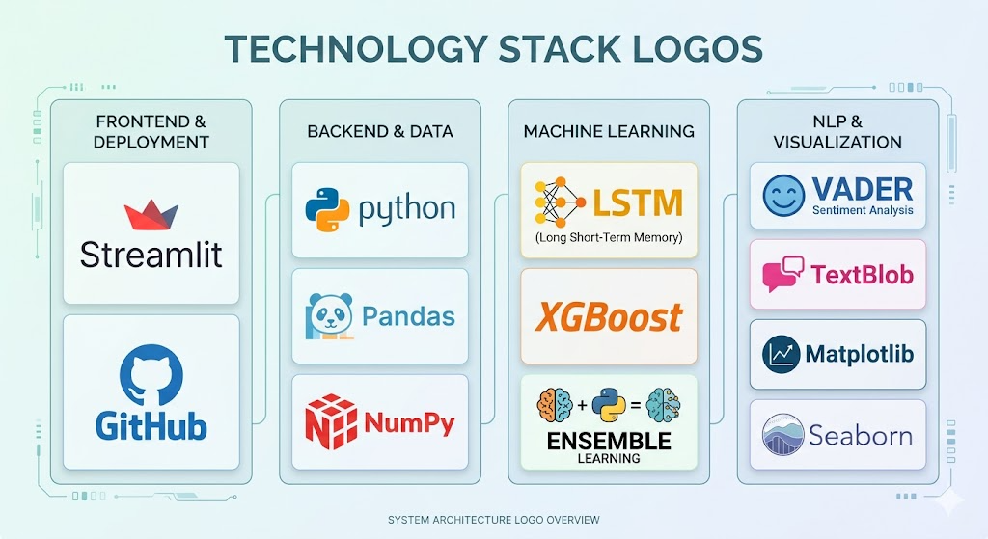
Tech Stack
Frontend: Streamlit
Backend:
• Python • Pandas • NumPy
Machine Learning
• LSTM (Time Series) • XGBoost (Regression) • Ensemble Learning
NLP
• VADER Sentiment Analysis • TextBlob
Visualization
• Matplotlib • Seaborn
Deployment: Streamlit Cloud, GitHub

Slide 6
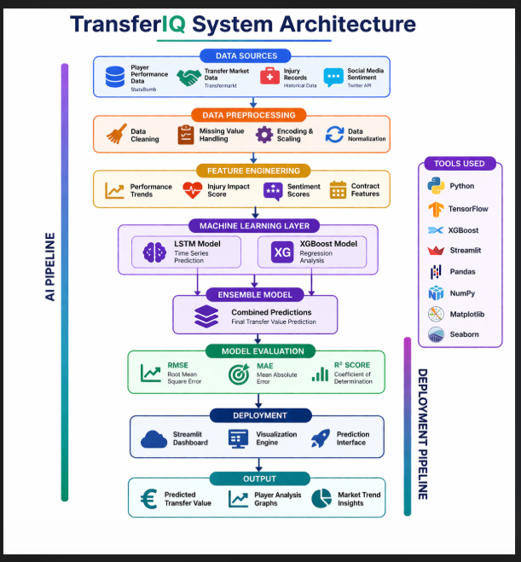
Work Flow Diagram

Slide 7
Comparison Of Models
Model | MAE (Mean Absolute Error) | RMSE (Root Mean Square Error) | R² Score
Uni LSTM | 2,348,569 | 10,235,180 | 0.827
Multi LSTM | 2,431,000 | 10,180,000 | 0.829
Tuned XGBoost | 3,122,850 | 10,167,490 | 0.829
Ensemble Model | 2,504,942 | 10,014,290 | 0.835

Slide 8
Feasibility & viability
Technical Feasibility
Open datasets available
Proven ML algorithms
Cloud deployment ready
Scalability
System can extend to:
Other sports
Player performance prediction
Injury risk prediction
Business Viability
Potential users:
• Football clubs • Scouts • Analysts • Sports agencies

Slide 9
Impact And Benefits
Benefits
For Clubs:
• Accurate valuation • Budget optimization
For Analysts:
• Performance insights • Trend prediction
For Industry:
• Sports analytics advancement
Impact
TransferIQ enables:
Smart transfer decisions
Risk reduction
Data driven scouting
Market trend analysis

Slide 10
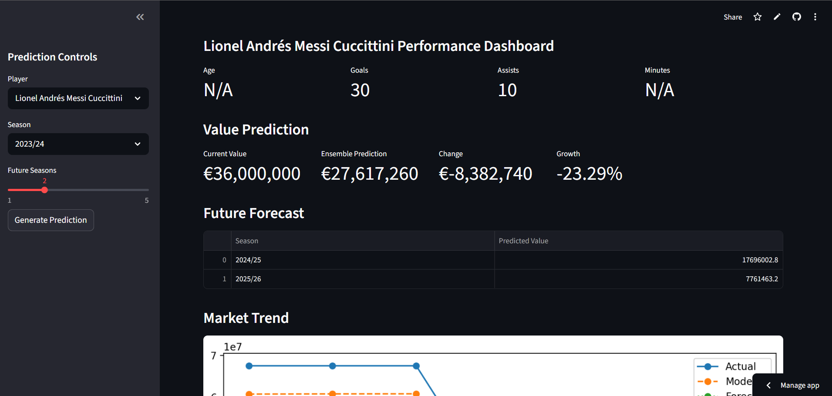
Result (UI)

Slide 11
Conclusion
TransferIQ demonstrates how AI can transform sports analytics by providing accurate and dynamic player valuation.
The integration of LSTM, ensemble learning and NLP creates a powerful prediction system.
Live Project:
https://transfer-iq-2tummjybe7u7tzkl3wxyzz.streamlit.app/

Slide 12
Thank you

